Slide 1
Tribal Equity Challenges
Ron Hall
Tribal Transportation Program Manager
Upper Great Plains Transportation Institute
North Dakota State University

Slide 2
Definitions of Equity
Equity The effort to provide different levels of support based on an individual’s or group’s needs in order to achieve fairness in outcomes. Working to achieve equity acknowledges unequal starting places and the need to correct the imbalance.
Equality The effort to treat everyone the same or to ensure that everyone has access to the same opportunities. However, only working to achieve equality ignores historical and structural factors that benefit some social groups and disadvantages other social groups in ways that create differential starting points.
CSSP (2019). “Key Equity Terms and Concepts: A Glossary for Shared Understanding.” Washington, DC: Center for the Study of Social Policy

Slide 3
Executive order 93185
(a) The term ‘‘equity’’ means the consistent and systematic fair, just, and impartial treatment of all individuals, including individuals who belong to underserved communities that have been denied such treatment, such as Black, Latino, and Indigenous and Native American persons, Asian Americans and Pacific Islanders and other persons of color; members of religious minorities; lesbian, gay, bisexual, transgender, and queer (LGBTQ+) persons; persons with disabilities; persons who live in rural areas; and persons otherwise adversely affected by persistent poverty or inequality.
EO 93185 Advancing Racial Equity and Support for Underserved Communities Through the Federal Government

Slide 4
TRB Equity Definition National Academies of Sciences, Engineering, and Medicine 2020. Equity Analysis in Regional Transportation Planning Processes, Volume 1: Guide. Washington, DC: The National Academies Press
Equity in transportation seeks fairness in mobility and accessibility to meet the needs of all community members. A central goal of transportation equity is to facilitate social and economic opportunities by providing equitable levels of access to affordable and reliable transportation options based on the needs of the populations being served, particularly populations that are traditionally underserved. This population group includes low income individuals, minority individuals, elderly persons, children, people with LEP, and/or persons with disabilities.

Slide 5
What is missing?
Recognition of Tribes in the Equity Analysis
Native American people are included, but presents challenges
In 2010 78% of AI/AN lived outside Tribal Statistical Areas
Equity compared to what?
Tribal DOT to State DOT?
AI/AN to White Non-Hispanic?
Tribe to Tribe? (Equity within TTP)

Slide 6
23 USC §201 Federal Lands and Tribal Transportation Programs
(a)Purpose.—Recognizing the need for all public Federal and tribal transportation facilities to be treated under uniform policies similar to the policies that apply to Federal-aid highways and other public transportation facilities, the Secretary of Transportation, in collaboration with the Secretaries of the appropriate Federal land management agencies, shall coordinate a uniform policy for all public Federal and tribal transportation facilities that shall apply to Federal lands transportation facilities, tribal transportation facilities, and Federal lands access transportation facilities.

Slide 7
$9.8 Billion State DOT COVID funding
relief money can be used by state DOTs to fund Surface Transportation Block Grant-eligible projects as well as for preventive maintenance, routine maintenance, operations, and personnel – including employee and contractor salaries – along with debt service payments, availability payments, and coverage for other revenue losses.
funds spent on maintenance and administrative expenses are not required to be included in either metropolitan or statewide long-range transportation improvement programs.

Slide 8
TTP Funding (574 Federally Recognized tribes)
TTP FY 2020
$422,975,370 available to tribes
$321,214,896 expended by tribes
$115,324,626 spent non-construction
$205,890,207 spent on construction
$101,760,474 unspent
$43.4 billion apportioned to states
Tribes receive .96% of amount provided to states
492 tribes received less than $1 million dollars from TTP in 2017
84 tribes received $1 million or more in 2017
13 tribes received $5 million or more in 2017
10 tribes received 33% of TTP funds in 2017

Slide 9
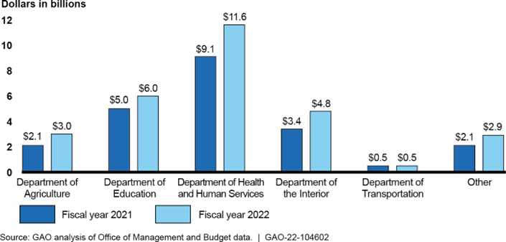
Proposed Funding for Programs That Benefit Native Americans, Fiscal Years 2021 and 2022 President’s Budget

Slide 10
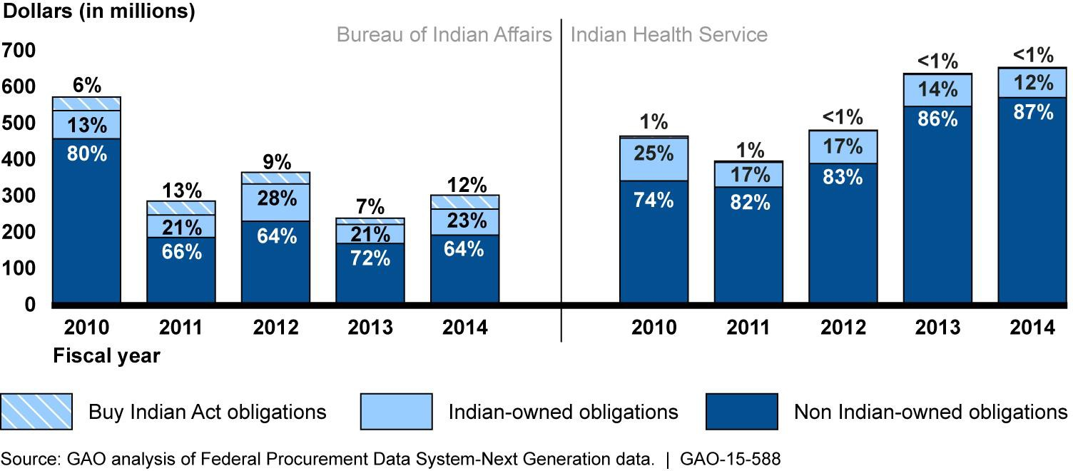
Total Annual Contract Obligations

Slide 11
Opportunities to Define and Advance Equity for Tribal Governments and Native American Communities
Implement 23 USC §201 mandate for a uniform policy for all federal and tribal transportation facilities
Include a definition of equity regarding the treatment of tribal governments in administration of federal transportation programs
Identify the historic policies of genocide, assimilation, relocation, land and resources taking, reorganization, termination and self-determination and their present impacts on tribal administration of transportation programs

Slide 12
Data Equity
Tribal capacity for data collection and analysis
Tribal access to data (Cobell impacts)
Identify tribal and AI/AN presence in all datasets
Identify anomalies in the data and ask why.
Follow the money – how much goes to DBE and Buy Indian contractors?

Slide 13
Equity performance measures
Results from Tribal Consultation and AI/AN community engagement
Impacts of historic and structural racism
Wealth accumulation
Wage and benefits disparities
Health
Education
Safety
How does transportation factor in for tribes?

Slide 14
Thank you

