Slide 1
Intertribal Transportation Association
December 8, 2022
Transportation’s Role in Broadband Deployment

Slide 2
Ice Breaker
How much do you use the internet every day?
What do you use the internet for?
Work
Telehealth
Connect with family and friends
Watch tv/movies
Operate a business
Education
Others?

Slide 3
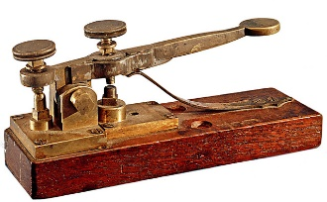
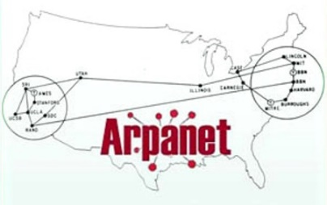
History of Telecommunications
Communications Act of 1934
1800’s
1900’s
2000’s

Slide 4
History of Telecommunications
Telecommunications Act of 1996
Presidential Memo (March 2015)
Executive Order 13616 (June 2012)
Executive Order 13821 (January 2018)
1990
2018 Mobile Now Act
2000’s
2010’s
2020’s

Slide 5
Focus On Broadband
BIL provides a historic investment in broadband infrastructure deployment
COVID-19 revealed the need for broadband
DOI/BIA National Tribal Broadband Summit
Multiple White House inquiries, including on coordination between Federal Agencies

Slide 6
Broadband Infrastructure Funding
$44B provided for broadband access across country (2015-2020)
National Telecommunications and Information Administration (NTIA)
$1B for Tribal Broadband Connectivity Program (Consolidated Appropriations Act, 2021)
$2B appropriated additional funds from BIL
121 Awards, $1.66B (November 30, 2022), TBCP Award Map
$42B appropriated for the Broadband Equity, Access, and Deployment (BEAD) Program
Many other funding sources

Slide 7
FHWA OTT-Broadband Deployment Initiative
Blane Kunihisa, Blane.Kunihisa@dot.gov
Darcel Collins, Darcel.Collins@dot.gov
Kyle Kitchel, Kyle.Kitchel@dot.gov

Slide 8
Objectives of this Presentation
Inform you about:
Focus on Broadband Infrastructure
FHWA’s role in broadband deployment
Tribal Transportation Departments role in broadband deployment
Provide resources
Provide OTT contact for interested Tribes

Slide 9
Question
Who here knows someone that doesn’t have broadband access at their house?

Slide 10
What’s the Problem? FCC Estimate from GAO Reports
Broadband Service (America)
Broadband Service (Tribal Lands)
Notes:
GAO Report to Congressional Requesters, Tribal Broadband FCC Should Undertake Efforts to Better Promote Tribal Access to Spectrum, November 2018
GAO Report to Congressional Requesters, Tribal Broadband National Strategy and Coordination Framework Needed to Increase Access, June 2022

Slide 11
What’s the Problem? FCC Estimate from GAO Reports
Broadband Service
(Rural America - Tribal Lands)
Broadband Service (Rural America)
Notes:
GAO Report to Congressional Requesters, Tribal Broadband FCC Should Undertake Efforts to Better Promote Tribal Access to Spectrum, November 2018
GAO Report to Congressional Requesters, Tribal Broadband National Strategy and Coordination Framework Needed to Increase Access, June 2022

Slide 12
What’s the Problem?
Closing Digital Gap = Greater impact to those w/o Broadband
Digital Divide = Inequality
Challenges to Internet Service Providers
Low population = increased cost to ISP = increase to subscribers
Low Benefit-Cost for Providers
Adoption (cost of service, digital literacy, cost of equipment)
Deployment

Slide 13
What’s the Problem?
Barriers limiting Tribe’s and Providers ability in participating in federal broadband programs:
Numerous, but Fragmented federal programs
Difficult application requirements
Challenges in Identifying programs to suit their needs
Notes:
GAO Report to Congressional Requesters, Tribal Broadband National Strategy and Coordination Framework Needed to Increase Access, June 2022

Slide 14
Federal Agency Stakeholder
Federal Funding Workstream Members include:
Department of Agriculture Department of Commerce (NTIA) Appalachian Regional Commission Delta Regional Authority Department of Education Environmental Protection Agency Federal Communications Commission Department of Health and Human Services Department of Homeland Security | Department of Housing and Urban Development Institute of Museum and Library Services Department of the Interior Department of Labor National Science Foundation Office of Management and Budget Department of Treasury Department of Veteran Affairs

Slide 15
Federal Agency Stakeholders
Streamlining Federal Permitting Workstream Members include:
Department of Homeland Security Department of the Interior Department of Agriculture Department of Commerce (NTIA) Department of Defense Department of Transportation Department of Veteran Affairs | General Services Administration Council on Environmental Quality Advisory Council on Historic Preservation Federal Communications Commission Office of Management and Budget

Slide 16
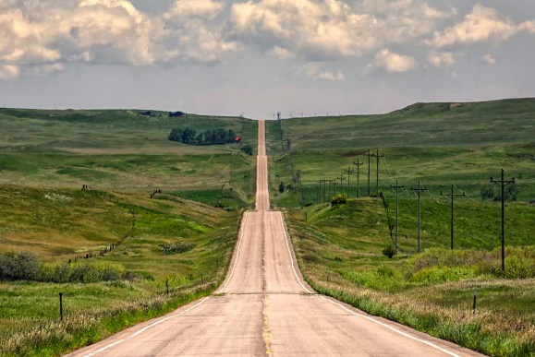
Federal Agency Stakeholders
Leverage Federal Assets Workstream Members include:
Department of the Interior General Services Administration Department of Agriculture Department of Commerce Department of Defense Department of Transportation Department of Energy Department of Homeland Security | Department of Housing and Urban Development Office of Management and Budget Environmental Protection Agency Department of Veteran Affairs National Aeronautics and Space Administration

Slide 17
Question
Why would a utility company want to use transportation right-of-way?
Less property owners to get permission
Transportation staff are knowledgeable in right-of-way

Slide 18
Transportation’s Role
FHWA
Public Interest Finding
FHWA Regulations (Federal-Aid Highway Program)
Policy Briefs
Tribe’s Planning
Coordination
Permitting

Slide 19
Utility Relocation and Accommodation on Federal Aid Highway Program Projects
Public Interest Finding
Transportation Safety
Dig Once Policy
Permitting
Mobile Now Act 2018

Slide 20
FHWA Regulation Public Interest Finding
23 CFR 645.205(a) states that:
“It is in the public interest for utility facilities to be accommodated on the right-of-way of a Federal-aid or direct Federal highway project when such use and occupancy of the highway right-of-way do not adversely affect highway or traffic safety, or otherwise impair the highway or its aesthetic quality, and do not conflict with the provisions of Federal, State or local laws or regulations.”

Slide 21
FHWA Regulation Safety
23 CFR 645.205(c) states that:
“…it is necessary that such use and occupancy, where authorized, be regulated by transportation departments in a manner which preserves the operational safety and the functional and aesthetic quality of the highway facility…”

Slide 22
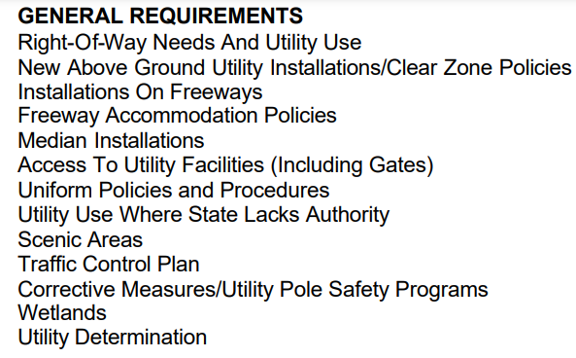
FHWA Utility Program Guide
FHWA Program Guide – Utility Relocation and Accommodation on Federal-Aid Highway Projects (https://www.fhwa.dot.gov/reports/utilguid/if03014.pdf)

Slide 23
FHWA Policy Brief Dig Once
Executive Order 13616 (June 2012) required FHWA to review “dig once” requirements
FCC – Burying utilities is largest cost for deploying broadband
Coordinate highway construction with broadband installation
Minimizes duplicative federal reviews and permits
https://www.fhwa.dot.gov/policy/otps/policy_brief_dig_once.pdf

Slide 24
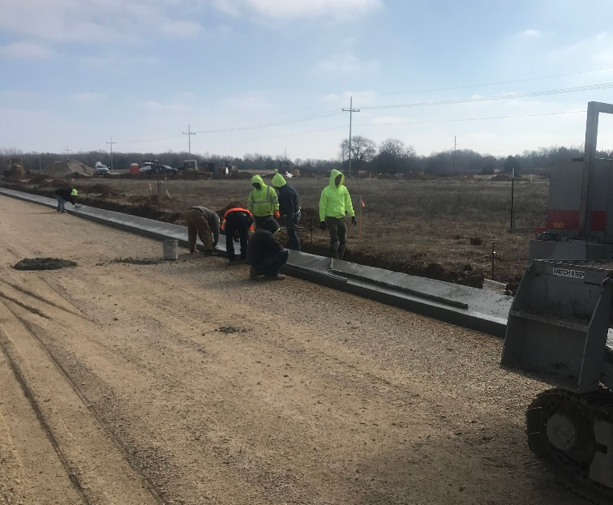
FHWA Regulation Right-of-Way
23 CFR 645.205(d):
The utility must also obtain and comply with the terms of a right-of-way or other occupancy permit for the Federal agency having jurisdiction over the underlying land.

Slide 25
2018 Mobile Now Act
State DOT’s shall:
Identify a broadband utility coordinator responsible for facilitating broadband infrastructure ROW efforts within the State
Coordinate telecommunication and broadband initiatives with State and local transportation and land use plans
Minimize repeated excavations of broadband infrastructure in a ROW
Establish process to register and notify broadband entities
Final Rule (https://www.govinfo.gov/content/pkg/FR-2021-12-03/pdf/2021-26231.pdf)

Slide 26
Coordination
Are you aware of your Tribe’s broadband deployment team?
Has a broadband deployment team contacted you about coordinating projects?
Does anyone want to provide an example/experience in working with a broadband team?

Slide 27
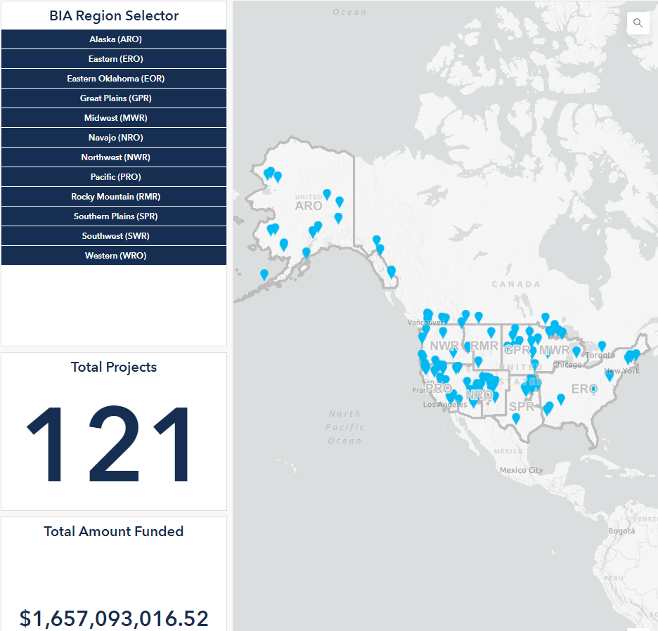
NTIA Tribal Broadband Connectivity Program

Slide 28
Planning a Community Broadband Roadmap NTIA Toolkit for Local and Tribal Governments
Assemble Broadband Team
Assess Existing Broadband
Engage Local Stakeholders
Choose Appropriate Technology
Select Business or Organizational Model
Develop Project Plan(s)
Implementation Plan
Financial Plan

Slide 29
FHWA Policy Brief Facilitate Deployment of Broadband Technology
Assemble Broadband Team
Assess Existing Broadband
Engage Local Stakeholders
Choose Appropriate Technology
Select Business or Organizational Model
Develop Project Plans(s)
Implementation Plan
Financial Plan
Your Transportation Department Should:
Familiarize yourself with State Accommodation Plan or BIA’s 25 CFR Part 169
Provide State or BIA Utility Accommodation Plan to Broadband Deployment Team
Publish broadband plans or utility accommodation policies on Transportation Dept. Website
Make existing utility location and proposed highway project information available electronically
Develop or update asset management system to collect broadband data
https://www.fhwa.dot.gov/policy/otps/pubs/policy_brief_rural_broadband.pdf

Slide 30
FHWA Policy Brief Facilitate Deployment of Broadband Technology
Assemble Broadband Team
Assess Existing Broadband
Engage Local Stakeholders
Choose Appropriate Technology
Select Business or Organizational Model
Develop Project Plans(s)
Implementation Plan
Financial Plan
Your Transportation Department Should:
Include broadband stakeholders and service providers in transportation planning
LRTP
TTIP
Coordinate transportation and highway construction plans with other statewide telecommunications plans
Coordinate with utilities to minimize number and scale of repeated excavations
https://www.fhwa.dot.gov/policy/otps/pubs/policy_brief_rural_broadband.pdf

Slide 31
Broadband in Transportation
Intelligent Transportation System (ITS)
Video cameras
Variable Message Signs
Advanced Surveillance Systems
Traffic Signals
Phones to access traveler information
GPS
CCTV
Radar Detectors
Pavement Sensors
Notes:
Broadband has many functions directly related to transportation.

Slide 32
Resources
FHWA Program Guide – Utility Relocation and Accommodation on Federal-Aid Highway Projects (https://www.fhwa.dot.gov/reports/utilguid/if03014.pdf)
FHWA’s Dig Once Policies (https://www.fhwa.dot.gov/policy/otps/policy_brief_dig_once.pdf)
FCC – Broadband Deployment Advisory Committee (BDAC) (https://www.fcc.gov/broadband-deployment-advisory-committee)
NTIA Broadband Deployment – “A Toolkit for Local and Tribal Governments” from Broadband USA (https://broadbandusa.ntia.doc.gov/resources/tribal-nations)

Slide 33
Resources
FHWA Case Study – UDOT Takes Active Role in Facilitating Broadband Deployment (https://www.fhwa.dot.gov/utilities/pdf/hif22040.pdf)
FHWA Policy Brief – Facilitating Broadband in Hard-to-Serve Areas (https://www.fhwa.dot.gov/policy/otps/pubs/policy_brief_rural_broadband.pdf)

Slide 34
Summary
We discussed:
FHWA’s role in broadband deployment
Tribal Transportation’s role in broadband deployment
FHWA Resources
OTT Contacts

Slide 35
Questions?
Office of Tribal Transportation
Broadband
Blane Kunihisa
Blane.Kunihisa@dot.gov
Office (360) 619-7814

