Slide 1
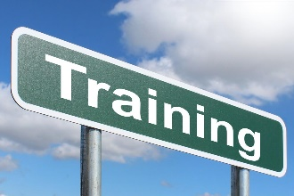
2021 ITA Annual Meeting Tribal Technical Assistance Program (TTAP) Update
Office of Transportation Workforce Development & Technology Deployment
Local Aid Support Team
December 8, 2021
TTAP Program Manager, Morgan Malley
morgan.malley@dot.gov

Slide 2
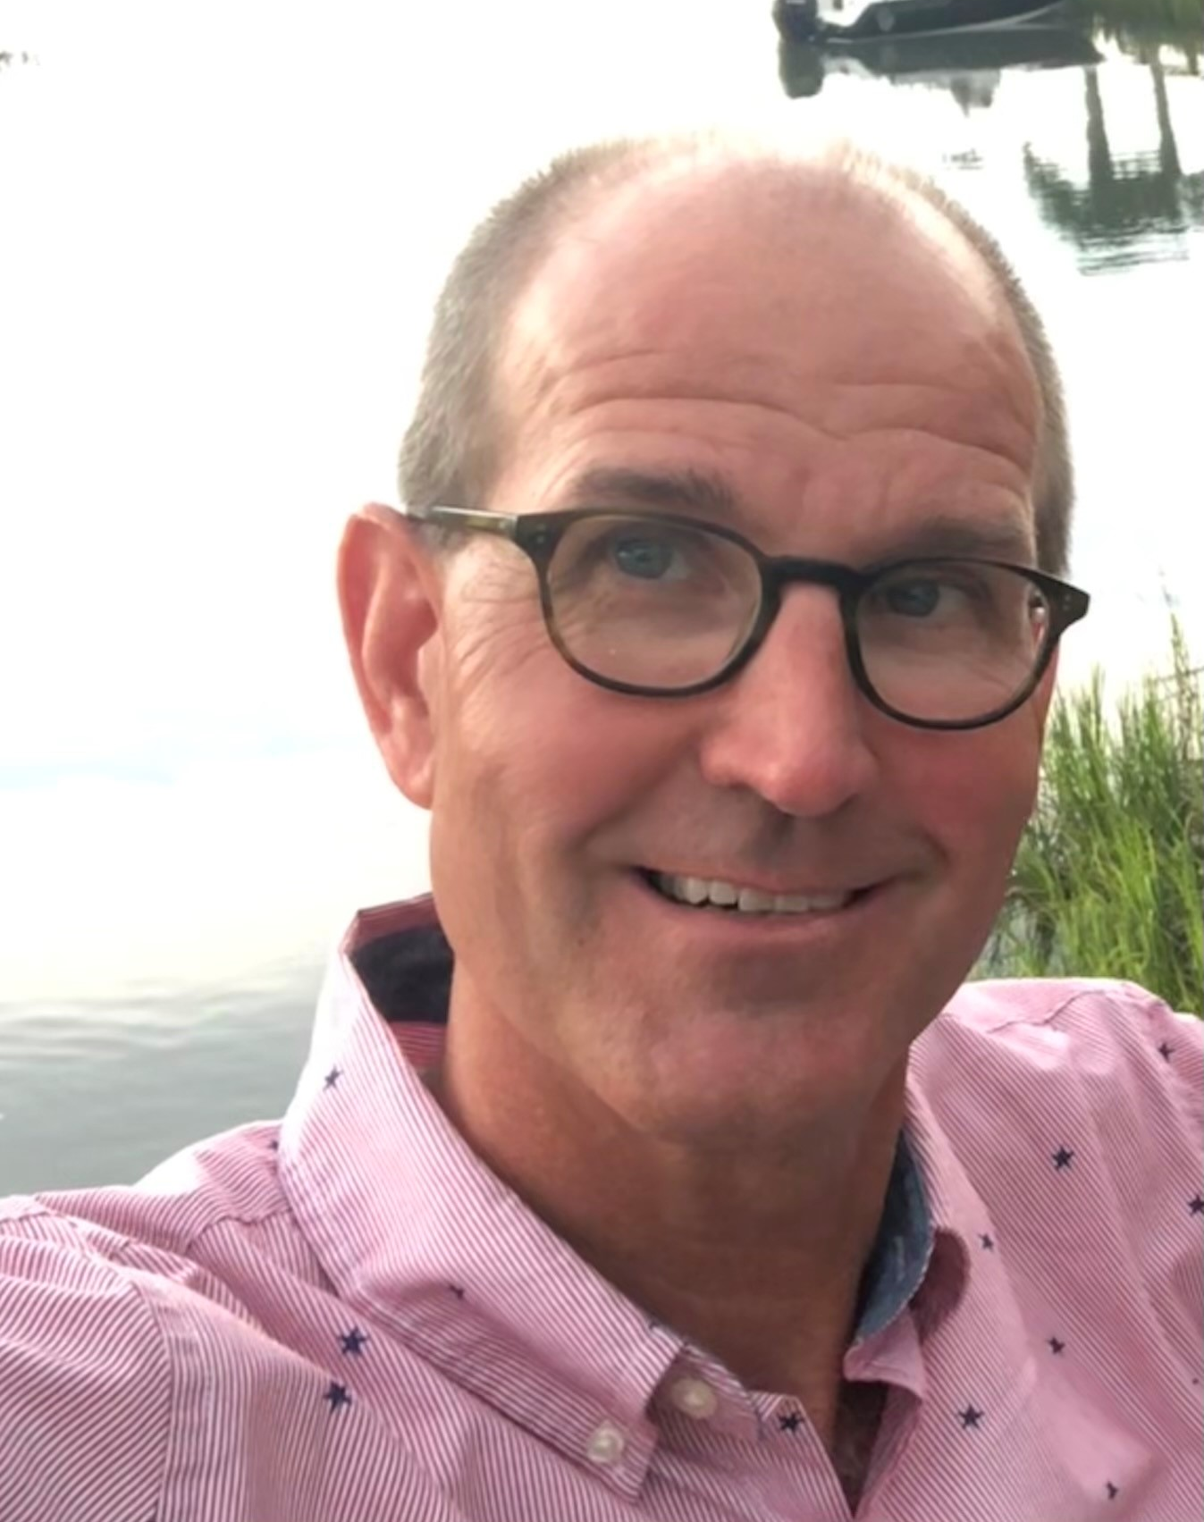
Local Aid Support Team
We provide training, technical assistance, and technology transfer services to build capacity for our Local and Tribal stakeholders that will enhance roadway networks, create economic opportunity, and improve quality of life.
Joe Conway
Local Aid Support Team Director
Office of Transportation Workforce Development and Technology Deployment
Danielle Mathis-Lee
LTAP Program Manager
Danielle.mathis-lee@dot.gov
Morgan Malley
TTAP Program Manager
Morgan.malley@dot.gov
Andrea Kirk
Transportation Program Manager
Andrea.kirk@dot.gov
Trinette Ballard
Transportation Program Manager
Trinette.ballard@dot.gov
WWW.FHWA.DOT.GOV/CLAS

Slide 3
National Program Mission: Through mutual respect and understanding,
enhance the quality of life in Tribal communities by building capacity for Tribes to administer and manage their transportation programs and systems.
Regional Center Vision: Serve as a go-to local resource for Tribal transportation training, technical assistance, and technology transfer needs and opportunities to effectively carry out the TTAP Mission.
TTAP Status:
Face-to-face training has been suspended as a future deliver model was assessed and a Notice of Funding (NOFO) prepared.
Online resources remain available during the temporary suspension.
It is anticipated that the TTAP NOFO will be published by the end of 2021, announcement of selection(s) by April 2022.
Informational webinar will be announced with NOFO publication.
WWW.FHWA.DOT.GOV/CLAS

Slide 4
TTAP Reimagined
Core TTAP Center Services
Training
Technical Assistance
Technology Transfer
Training Emphasis Areas
Program Management
Project Delivery
Infrastructure Management
+ Center Service Options*
Workforce Development
Safety Circuit Rider
Innovation Deployment
*Following establishment of Center(s), dependent on availability of funding.
Notes:
Why reimagined- Bipartisan Infrastructure Legislation (BIL), greater opportunity than ever before and how the TTAP can serve to deliver
Program Management- training on Tribal Transportation Program (TTP) Eligible Activities as defined in section 504(b)(2)(D)(ii) of title 23 legislation;
Project Delivery- training on delivery of Federal Aid transportation projects;
Infrastructure Management
Following establishment of Centers, as funds become available

Slide 5
Questions?

