Slide 1
Future Tribal Transportation Workforce Needs and Gap Analysis and Research Roadmap
Ron Hall, Bubar & Hall Consulting, LLC
Tyler Reeb, University of California Long Beach,
Terry Bills, Environmental Systems Research Institute
Cameron Ishaq, Faster Horse

Slide 2
Equity in Transportation
Transportation User Perspective:
Accessible, affordable and safe transportation for everyone in the community resulting in fair distribution of transportation resources, benefits, costs, programs and services based upon differences in income, ability and other factors affecting transportation choice and impact.
Transportation Provider Perspective:
Fair distribution of service levels and investments required to maintain parity

Slide 3
23 USC Section 201 – Federal and Tribal Lands Transportation Programs
(a)Purpose.—Recognizing the need for all public Federal and tribal transportation facilities to be treated under uniform policies similar to the policies that apply to Federal-aid highways and other public transportation facilities,
the Secretary of Transportation, in collaboration with the Secretaries of the appropriate Federal land management agencies, shall coordinate a uniform policy for all public Federal and tribal transportation facilities that shall apply to Federal lands transportation facilities, tribal transportation facilities, and Federal lands access transportation facilities.

Slide 4
Two Stage Approach
Form a Tribal Transportation Workforce Peer Review Panel
Identify Scope of Research Needs and Research Agenda
Pursue Funding for Research Needs Statements

Slide 5
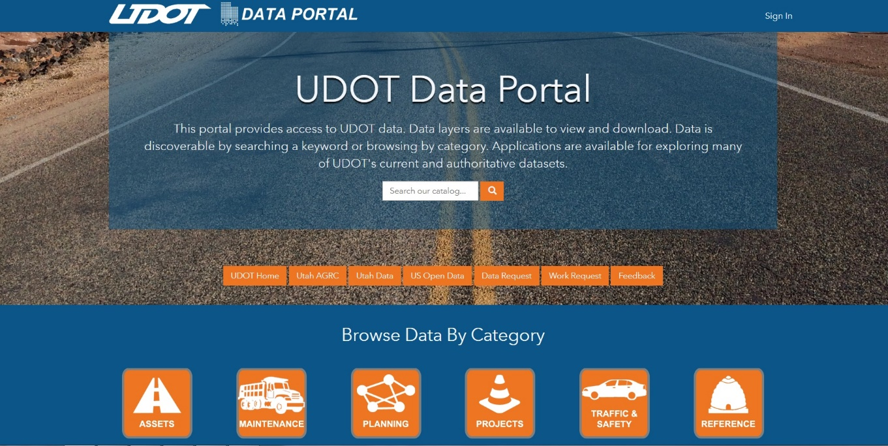
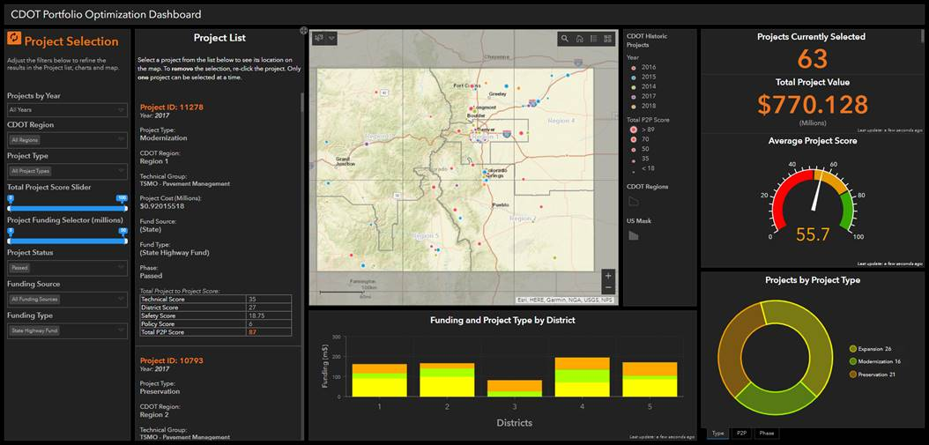
Domain & Technical Competencies
Key Transportation Skills: Project Planning, Asset Management / Maintenance, Safety
Key Technology Skills: Data Collection, Data Management, Data Analysis,

Slide 6
Equity through self-determination and collaboration
1928 Indian Reservation Road Program created and administered by BIA
Tribal Self-Determination Policy in Federal Transportation Policy and Law
Shift from Termination Policy
Indian Self Determination and Education Assistance Act of 1975
Intermodal Surface Transportation Efficiency Act of 1991
Self-Determination Policy applies to transportation program and funds in BIA
FAST Act 2015 applied Self-Determination and Self-Governance to DOT

Slide 7
Tribes Manage Transportation Infrastructure
1991 ISTEA
Tribes inherited a system that was planned and designed by others

Slide 8
Existing Road and Bridge System
930 BIA –owned bridges
164,000 miles of road National Tribal Transportation Field Inventory (NTTFI)

Slide 9
Tribal Management with Federal Standards and Requirements
Contract/Grant Management/Procurement
Planning and Design
Construction
Maintenance
Transit
Airports
Maritime
Alternative Transportation

Slide 10
Allignment of Policies
Tribal Self-Determination and Self-Governance
Federal-Aid Policies
Tribal Transportation Program Policies
FHWA
FTA
BIA

Slide 11
Research Objective
develop and deliver a needs and skills gap assessment of the transportation workforce of Tribal governments across the United States, and
offer options to help decision makers better understand and implement a suite of workforce development programs, resources, and materials that can help Tribal governments train and maintain their workforce.
Develop a Tribal Transportation Research Roadmap
Recommendations to develop targeted training and technical assistance initiatives that respond to various Tribal needs with regard to technology, infrastructure, mobility, administration, and demographics.

Slide 12
The process and intended outputs for this research are:
Establish a Peer Review Panel to guide the project
Design survey, outreach plan, and needs skills gap assessment based on tribal needs and objectives
Conduct assessments of current and emerging core competencies required of Tribal programs to effectively identify, manage, and address their transportation needs to include representation from tribes from varying circumstances including land base, land ownership, demographics, government structure, funding instruments (FHWA G to G, BIA G to G, BIA PL-638, BIA Direct Service), urban/rural, and other factors that relate to transportation needs and resources
Collaborate with Tribal governments and communities to determine and document systemic approaches to the provision of Tribal-specific, culturally relevant and mission-critical training and technical assistance services

Slide 13
Questions

