Slide 1
FTA Updates
for
Intertribal Transportation Association
2022 Annual Meeting
December 6, 2022
Amy Changchien
Deputy Regional Administrator, Region 9
Federal Transit Administration

Slide 2
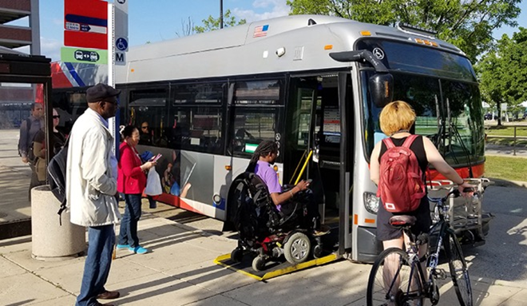
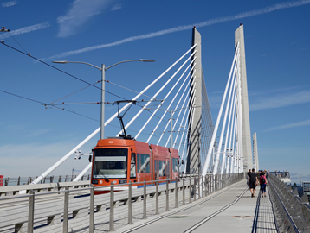
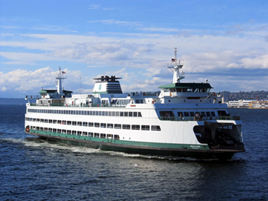
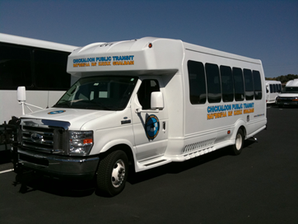
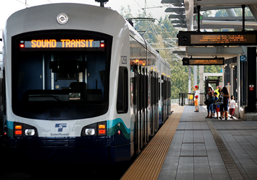
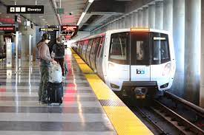
Federal Transit Administration (FTA) Overview
Vision
A Better Quality of Life for All Built Upon Public Transportation Excellence
Mission
Improving America’s communities through Public Transportation

Slide 3
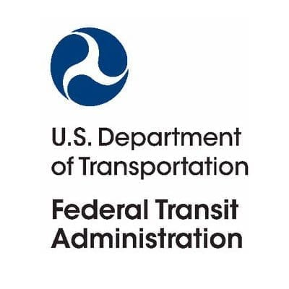
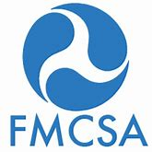
FTA Today
One of 9 modal administrations within USDOT
Approximately 600 staff
$20.4 billion annual budget in FY 2022
$69.4 billion in COVID-19 Emergency Relief
$25 billion in CARES Act funds in 2020
$14 billion in CRRSAA funds in 2021
$30.4 billion in ARP funds in 2021

Slide 4
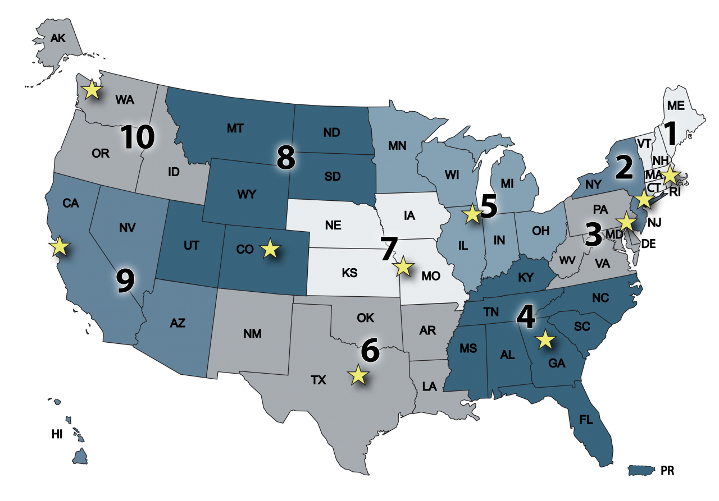
FTA – Regional Offices
10 Regional Offices
(TROs)
TRO-1: Cambridge, MA
TRO-2: New York, NY
TRO-3: Philadelphia, PA
Washington, DC
TRO-4: Atlanta, GA
San Juan, Puerto Rico
TRO-5: Chicago, IL
TRO-6: Fort Worth, TX
TRO-7: Kansas City, MO
TRO-8: Denver, CO
TRO-9: San Francisco, CA
Los Angeles, CA
TRO-10: Seattle, WA

Slide 5
Typical Transit Projects
Operating Assistance
Preventive Maintenance (vehicles and facilities)
Capital Projects (rail extensions, bus rapid transit, etc.)
Vehicles (railcars, buses, ferries, etc.)
Stations, Stops, and Terminals
Maintenance and Support Equipment and Facilities
Safety and Security Improvements
ADA Accessibility Improvements
Transportation Planning
Transit Access (sidewalks/crossings, first-mile & last-mile connection, etc.)

Slide 6
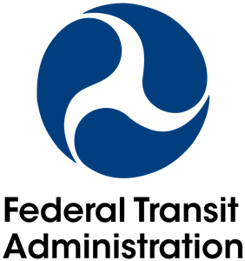
Grant Programs Supporting Tribal Transit

Slide 7
FTA Tribal Transit Program: Overview
Tribal Transit Program (TTP)
Objective: Provide direct funding to federally recognized Indian tribes to provide public transportation service on and around Indian reservations or tribal land in rural areas.
Eligible Recipients: Federally recognized American Indian or Alaska Native tribes as identified by the U.S. Department of the Interior (DOI) Bureau of Indian Affairs (BIA).
Eligible Activities: Capital, Operating and Planning projects

Slide 8
FTA Tribal Transit Program: Overview (cont’d)
Bipartisan Infrastructure Law (FY 2022-2026)
Increase funding levels for both TTP Formula and Competitive/Discretionary Programs and added an annual funding increase
Formula Program: Starting with $35 M per year with an annual increase ending with $38 M per year
Competitive Program: Starting at $8.75 M per year with an annual increase ending at $9.6 M per year
In Millions
Funding Program | FY 2021 | FY 2022 | FY 2023 | FY 2024 | FY 2025 | FY 2026
TTP Formula | $30.0 | $35.01 | $35.74 | $36.68 | $37.43 | $38.39
TTP Competitive | $5.0 | $8.75 | $8.94 | $9.17 | $9.36 | $9.60

Slide 9
FTA Tribal Transit Program: Formula (cont’d)
 | Eligible Projects | Federal Share | Funding Availability
TTP Formula Funds | Planning | 100% | 3 years (Year of Appropriation + 2)
 | Capital
 | Operating
 | Administrative Expenses

Slide 10
FTA Tribal Transit Program: Competitive
(cont’d)
 | Eligible Projects | Federal Share | Funding Availability
TTP Competitive Funds | Planning $25,000 cap | 100% | 3 years (Year of Allocation + 2)
 | Capital New Services Replacement (bus, equipment, facility) Expansion (bus, equipment, facility) Project Administration
 | Operating New Services Existing Services

Slide 11
FTA Tribal Transit Program: FY 2022 Competitive
On October 11, 2022, FTA announced approximately $8.6 million in FY 22 Tribal Transit Program funds for 25 Tribal Governments
FTA received 47 applications from 47 Tribes in 17 states, totaling over $ 18 million.
Grant awards support capital, planning and operating assistance
No local match is required for these funds. Federal share is 100%
Funds will lapse on September 30, 2025
Technical assistance is provided through debriefs for unsuccessful applicants

Slide 12
FTA Tribal Transit Program: Grantees

Slide 13
FTA Formula Funds Available for Tribes
Funding Program | Direct Grant with FTA | Grant through State DOT
Section 5310 – Elderly and Persons with Disabilities | X | X
Section 5311 – Rural Area Transportation | X | X
Section 5311(j) – Tribal Transit Program – Formula | X
Section 5339(a) – Bus and Bus Facilities | X | X

Slide 14
FTA Competitive Funds Available for Tribes
Funding Program | Direct Grant with FTA | Grant through State DOT
FAST 3006(b) – Innovative Coordinated Access and Mobility | X | X
Section 5309 - Capital Investment Grant | X | X
Section 5311(j) – Tribal Transit Program | X
Section 5312 – Integrated Mobility Innovation | X | X
Section 5339(b) – Bus and Bus Facilities | X | X
Section 5339(c) – Low or No Emission Vehicles | X | X

Slide 15
TTP vs. Non-TTP Requirements
Tribes are eligible for Section 5311 Formula Grants for Rural Areas funding (administered by State DOTs) as subrecipients of the state.
To receive Section 5311 funding, Tribes must comply with the requirements of the program, including cost-sharing (match) and Title VI requirements. These requirements differ from the TTP program requirements, where Tribes have been granted certain exemptions.
Tribes also have the option to receive their Section 5311 or other program funding directly through FTA, but the program-specific requirements will still apply.

Slide 16
COVID-19 Emergency Relief Funding
Coronavirus Aid, Relief, and Economic Security (CARES) Act
Coronavirus Response and Relief Supplemental Appropriations Act of 2021 (CRRSAA)
American Rescue Plan (ARP) Act of 2021
https://www.transit.dot.gov/coronavirus

Slide 17
COVID-19 Emergency Relief Funding (cont’d)
Tribes received set-aside formula funding under CARES, CRRSA and ARP Acts, totaling $90 million.
ARP Act also provided $5 million in Tribal competitive funding.
Under CARES Act, 95% of Tribal formula funds obligated
Under CRRSAA, 64% of TTP formula funds obligated
Under ARP Act, 46% of TTP formula funds obligated and 39% of TTP competitive funds obligated
Funding Availability Period
CARES Act and CRRSAA funds are available until expended.
ARP Act funds must be obligated by September 30, 2024 and disbursed by September 30, 2029.

Slide 18
USDOT Grant Programs
RAISE - Rebuilding American Infrastructure with Sustainability and Equity Program
Safe Streets for All (SS4A)
ROUTES - Rural Opportunities to Use Transportation for Economic Success
RURAL - Rural Surface Transportation Grant program, which was included as part of USDOT’s Multimodal Project Discretionary Grant Opportunity (MPDG)
Complete list of grant programs for USDOT and its modal administrations can be found here: https://www.transportation.gov/grants

Slide 19
Regulation and Policy Updates

Slide 20
Tribal Transportation Self-Governance Program (TTSGP)
USDOT’s Tribal Transportation Self-Governance Program (TTSGP) became effective October 1, 2020.
The Cherokee Nation is the first Tribal Nation recipient of the program on June 7, 2022.
Both FTA HQs and Regional staff assisted Secretary of Transportation’s Office (OST) to ensure the successful signing of the compact.
FTA continues to support TTSGP and the implementation of the program, particularly when Tribes receiving FTA funds express interest and pursue participation in the program.

Slide 21
Commercial Driver’s License (CDL)…
New Entry-Level Driver Training (ELDT) regulations were issued by Federal Motor Carrier Safety Administration (FMCSA) and became effective on February 7, 2022.
Individuals applying to obtain a school bus(S), passenger (P), or hazardous materials (H) endorsement for the first time after February 7, 2022 must comply with the ELDT requirements.
More information about ELDT regulations is available on the FMCSA website: https://www.fmcsa.dot.gov/registration/commercial-drivers-license/entry-level-driver-training-eldt.
FTA’s National Rural Technical Assistance Program (NRTAP) is developing a transit CDL training for rural and tribal operators in collaboration with Minnesota DOT.

Slide 22
Hiring Preference
In 2021, FTA announced a pilot initiative to permit transit agencies apply hiring preferences on FTA-funded construction projects, to promote equitable creation of employment opportunities and workforce development activities, particularly for economically or socially disadvantaged workers.
Bipartisan Infrastructure Law (BIL) includes hiring preferences provision related to the use of labor for transportation construction projects.
BIL Section 25019 provides an expressed authorization for FTA grant recipients and subrecipients to use a local or other geographical or economic hiring preference for the construction of federally supported transit projects.
For more details, see February 10, 2022 Federal Register Notice

Slide 23
Transit Workforce Center
Transit Workforce Center (TWC) is the first FTA-funded center directly support workforce development to help transit agencies recruit, hire, train, and retain a diverse workforce.
FTA created a campaign toolkit to support the transit industry with innovative, site-specific approaches to recruit transit workers, especially bus operators and maintenance workers.
ConnectingMyCommunity: The National Transit Frontline Worker Campaign Toolkit features:
Tips and strategies
Customizable advertising templates with graphics and messages
A library of videos, other advertising, case studies on successful recruitment strategies, and recruitment-related research and reports

Slide 24
Vehicle Availability Challenges
FTA is aware of challenges that transit agencies are having with procurement of cutaways in today’s difficult supply chain environment.
FTA is currently in dialogue with small bus manufacturers and customers to identify where USDOT and FTA can provide assistance in relieving the chassis shortage.
FTA intends to issue guidance to clarify requirements related to procurement and flexibilities available to transit agencies.
FTA staff are available to help you to amend formula grants, and in some limited cases, discretionary grants to adjust them to today’s market conditions.

Slide 25
Partial General Non-availability Waiver
Waiver scope
In response to multiple grantee requests and the unavailability of non-ADA accessible vans or minivans that are Buy America compliant, FTA issued a new van/minivan waiver on October 25, 2022.
Applies to unmodified, mass produced vans and minivans used in vanpool and other public transportation service.
Under the waiver, vans and minivans must be:
Capable of vanpool service (minimum 6 passengers + driver)
Final assembly in United States as reported in American Automobile Labeling Act (AALA) reports (available on NHTSA’s public website)
Engine origin in United States as reported in AALA reports
Waiver expires in two years (October 24, 2024), or earlier if a Buy America-compliant vehicle becomes available

Slide 26
Partial General Non-availability Waiver (cont’d)
Because the waiver requests were specific to vanpool service, the waiver does not apply to:
Vehicles not vanpool-eligible (fewer than 6 seats + the driver)
ADA-accessible conversion vans and minivans
Van and minivan “chassis” for conversion into ADA-accessible vehicles
Buses, cutaway vehicles, shuttles. Vehicles that carry more than 12 persons are not covered by AALA.

Slide 27
Build America Buy America Act (BABA)
On November 15, 2021, the Build America, Buy America Act (BABA) (Sections 70901-52 of the Infrastructure Investment and Jobs Act, Public Law 117-58) became law.
On April 18, 2022, the U.S. Office of Management and Budget (OMB) issued memorandum M-22-11, “Initial Implementation Guidance on Application of Buy America Preference in Federal Financial Assistance Programs for Infrastructure,” to guide federal agencies’ initial implementation of BABA. OMB also has published a request for information and invited public comments on key questions related to implementing BABA.
On May 19, 2022, USDOT issued a general waiver that delays the effective date of BABA’s domestic preference requirements for construction materials, until November 10, 2022.

Slide 28
BABA – Construction Materials
USDOT is taking three actions:
Not extending its temporary waiver (expired November 10, 2022) for construction materials.
Proposing a waiver for narrow categories of contracts and solicitations to help certain ongoing procurements transition to the new construction materials standard
Proposing a narrow waiver for de minimis costs, small grants, and minor components to allow USDOT and its grant recipients to focus their domestic sourcing efforts on products USDOT sought comments by November 20, 2022 on the two proposed waivers.
FTA Administrator’s Dear Colleague letter to transit agencies on Buy America obligations on FTA-funded projects
More information is available on the DOT and FTA Buy America websites

Slide 29
Bipartisan Infrastructure Law -Information
https://www.transit.dot.gov/BIL
FTA BIL Program Fact Sheets for existing and new programs and funding levels
Sign up to receive FTA email updates
Webinars and Listening Sessions
Town Hall Meetings
Storytelling

Slide 30
Resources

Slide 31
Resources
FTA Tribal Transit Program Manager
Ms. Elan Flippin-Jones elan.flippin@dot.gov; 202-366-3800
FTA Regional Tribal Transit Liaisons https://www.transit.dot.gov/funding/grants/federal-transit-administrations-regional-tribal-liaisons
FTA Grant Programs https://www.transit.dot.gov/funding
USDOT Grant Programs https://www.transportation.gov/grants
Transit Workforce Center https://www.transitworkforce.org/
Buy America https://www.transit.dot.gov/buyamerica
National Rural Transit Assistance Program https://www.nationalrtap.org/

Slide 32
Contact Information:
Amy Changchien
Deputy Regional Administrator
FTA – Region 9 Office (San Francisco)
amy.changchien@dot.gov
Office: 415-734-9455
Mobile: 202-641-6130

Slide 33
