Slide 1
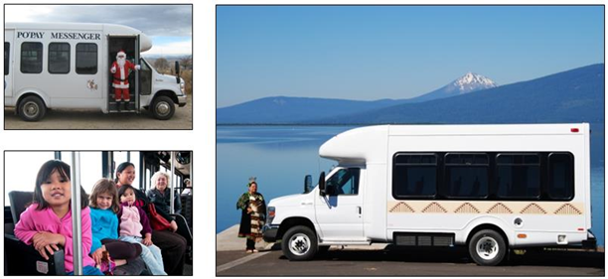
FTA’s Tribal Transit Program: History and Growth
ITA December 8, 2021
Place any image here If you do not want to use a
cover image,
delete this slide and use the next
slide instead
Marianne Stock
Office of Program Management
Federal Transit Administration

Slide 2
History of the Tribal Transit Program
SAFETEA-LU (FY 2006-2012)
Created the Tribal Transit Program
Administered as a discretionary program at approximately $15 million/ year
MAP-21(FY 2013-2015)
Continued and Modified TTP
Formula Program: $25M per year
Competitive Program: $5M per year
TTP totaled $30M per year

Slide 3
History of the Tribal Transit Program
The FAST Act (FY 2016-2021)
Continued the Tribal Transit Program and increased the formula program
Formula Program : $30M per year
Competitive Program: $5M per year
TTP totaled $35M per year

Slide 4
The Tribal Transit Program today
The Bipartisan Infrastructure Law (FY 2022-2026)
Continued and increased the Tribal Transit Program
Instead of a flat amount each year, the Tribal Transit Program now grows with the rural transit program
TTP now totals $229M over five-year period
Formula funds: $183 million
Competitive funds: $45.8 million
Supports 132 Indian Tribes and Alaska Native Villages with transit service
Notes:
$229 million in funding for Public Transportation on Indian Reservations Grants, including $183 million in formula grants and $45.8 million in competitive grants. This is a combined $54.1 million in additional funding over five years compared to the final year of the FAST Act.
This funding will support 132 Indian Tribes and Alaskan Native villages to purchase transit vehicles, construct facilities, undertake transit planning, and operate and maintain their systems.
TTP gets 5 percent of 5311. 20% of TTP is competitive

Slide 5
The Tribal Transit Program today
The Bipartisan Infrastructure Law (FY 2022-2026)
TTP Annual Funding: $43.76M in FY 22; $47.99M in FY 26
Formula Program: $35M-$38M (FY 22-26)
Competitive Program: $8M-$9.6M (FY 22-26)
Notes:
Total TTP funding: $43.76M in FY 22; $47.99M in FY 26
Formula Program: $35M-$38M (FY 22-26)
Competitive Program: $8M-$9.6M (FY 22-26)
In FY 22, program as a whole jumps $8.8 million over FY 21. (25%)
The last year is a 37 percent increase over FY 21, $13 million.

Slide 6
