Slide 1
FLH Office of Tribal Transportation
2020 ITA “Virtual” Annual Meeting
December 9th, 2020
Erin Kenley, Director
Office of Tribal Transportation

Slide 2
Update Topics
TTP
FAST Act Funding
Safety Fund
Bridge Program
Webinar Series
FHL Research Program
NSFLTP
Email ListServ

Slide 3
FAST Act TTP Funding
Fixing America’s Surface Transportation Act
5 year Highway Bill (FY16 – FY20)
Tribal Transportation Program (TTP) Funding
FY16 - $465 Million
FY17 - $475 Million
FY18 - $485 Million
FY19 - $495 Million
FY20 - $505 Million
TOTAL - $2.425 Billion over 5 years
FY21 - $505 Million

Slide 4
FY20 TTPSF Application Data
Applications: 140
Requested: $37.6 million
Available: $ 9,150,600
3 of 4 requested dollars will go unfunded
Adam Larsen
FHWA Office of Tribal Transportation
360-619-7751
Adam.Larsen@DOT.gov

Slide 5
TTP Safety Fund History
 | 2013 | 2014 | 2015 | 2016 | 17-18 | 2019 | 2020
Funds Available (millions) | $8.6 | $8.5 | $8.5 | $9 | $17 | $8.9 | $9.15
Funds Requested (millions) | $27.2 | $27.1 | $37 | $40.1 | $90 | $38 | $37.6
Applications | 239 | 127 | 167 | 171 | 234 | 159 | 140
Awards | 193 | 94 | 90 | 77 | 94 | 91

Slide 6
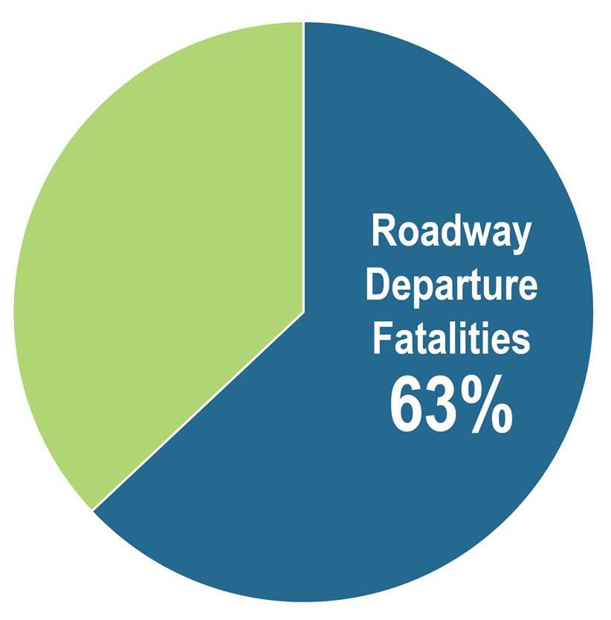
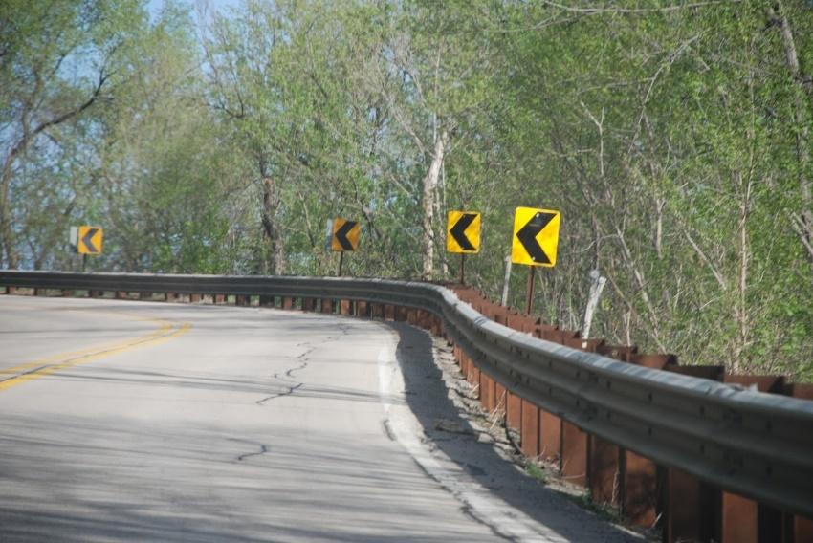
FY21 TTP Safety Fund New Roadway Departure Category
FY21 TTPSF will establish a 25% funding goal for specific road safety countermeasures that address roadway departure such as:
Curve signage
Delineation
Rumble strip/stripes
Mitigate roadside hazards
Details pending.
https://www.tribalsafety.org/Run-Off-the-Road
Tribal Areas

Slide 7
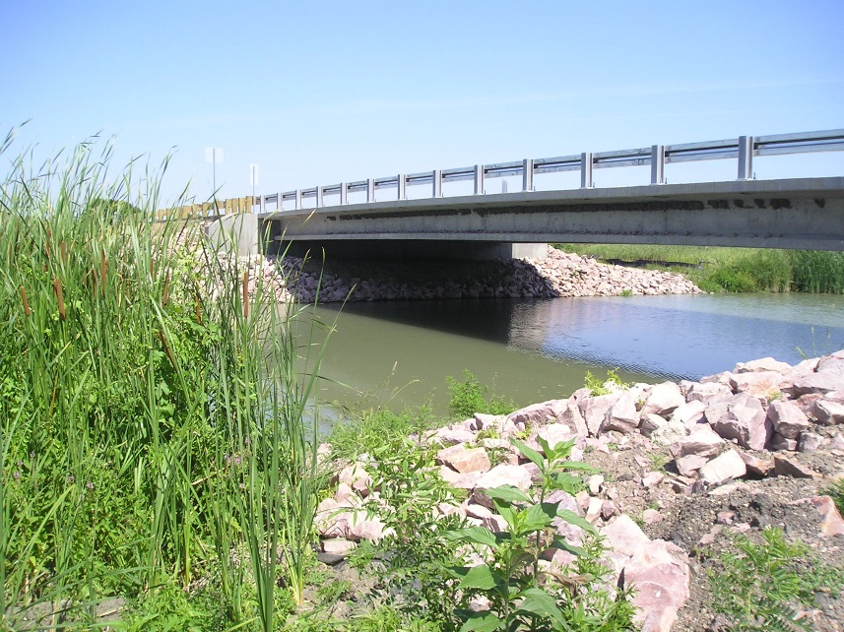
TTP Bridge Program NPRM
The rulemaking will update the IRR Bridge Program regulations, align it with the changes made under MAP-21 and the FAST Act.
Delete the structurally deficient, functionally obsolete, and sufficiency rating language to align the TTP Bridge Program terminology for bridge conditions with the terminology used for State DOTs in the Federal-aid Highway Program.
New terminology for condition ratings: Good, Fair, and Poor
NPRM Designation: Non-significant
Planned Publication Date in the Fed. Register: Fall 2020
Request for Comments Deadline: 30 days after publication in the Federal Register.
Russell Garcia
Bridge Program Manager
Office of Tribal Transportation
Federal Highway Administration
( Work Phone: 703-404-6223 8 E-mail: Russell.Garcia@dot.gov

Slide 8
TTP Bridge Program FY20 NBI Data Submittal
BIA NBI Data Submittal – 1,021 BIA bridges
Tribal NBI Data Submittal – 122 Tribal bridges
68 Tribal bridge data from FHWA Tribes
54 Tribal bridge data from BIA Tribes

Slide 9
TTP Bridge Program TTP Bridge Program Funds
Funds made available in FY20 = $13.7M
Received 25 bridge applications for $29M total funding request
Funded 16 bridge projects for $13.7M
7 from FHWA Tribes $5.7M; 9 from BIA Tribes $8M
9 projects not funded in FY20 = $15.3M
Partially Funded one project – Navajo Nation bridge

Slide 10
TTP Webinar Series – Spring 2020
Session | Date | Topic
#1 | April 8th | Part 1: Introduction to webinar series presentation & FHWA Office of Tribal Transportation update Part 2: Tribal Transportation Program Coordinating Committee update
#2 | April 15th | Allowable uses of TTP Funds / PORT
#3 | April 22nd | Traffic Control for Road Restrictions
#4 | April 29th | TTP Finance
#5 | May 6th | Part 1: ER/ERFO/FEMA Part 2: Federal Resources for Tribal Transit Programs and FTA Policy Updates
#6 | May 13th | Grant Writing
#7 | May 20th | Safety Funding Update
#8 | May 28th | Construction Management
#9 | June 3rd | Tribal Bridge Program Update
#10 | June 10th | BIA Division of Energy and Mineral Development
 | Recordings Available | https://highways.dot.gov/federal-lands/programs-tribal/webinars

Slide 11
TTP Webinar Series – Upcoming Webinars
Session | Date | Topic
#1 | September 16th | TTP 101 - Tribal Transportation Program - An overview of the purpose and policies of Tribal Transportation Program, including laws and regulations that govern the program.
#2 | October 21st | TTP 101 – Planning - The Tribal Transportation Planning processes and documents that are required to deliver the Tribal Transportation Program.
#3 | November 18th | Construction Management/General Contractor (CM/GC) Roundtable
#4 | December 16th | TTP 101 – Project Development - The documentation required for the project package, which is required prior to starting construction
#5 | January 20th 2021 | TTP 101 - Construction - Construction management best practices and construction project closeout requirements.
 | Updates Posted | https://highways.dot.gov/federal-lands/programs-tribal/webinars

Slide 12
FLH Research Program
11 Research Statements Selected
$4.3 Million
Awarded 4 Projects ($800K):
Making Transportation Planning Applicable in Tribal Communities - $300K
Applying FHWA’s Vulnerability Assessment and Adaptation Framework to Tribal Communities - $100K
Ice Road Establishment and Management AND Trail and Shelter Protocols and Standards $400K
POC Aung.Gye@dot.gov

Slide 13
Nationally Significant Federal Lands and Tribal Projects (NSFLTP)
NOFO Closed
$70 Million
60 day application window
https://highways.dot.gov/federal-lands/programs/significant
Jeff Mann Senior Program and Technical Manager Office of Federal Lands Highway Phone: (703) 404-6230 Email: jeffrey.mann@dot.gov

Slide 14
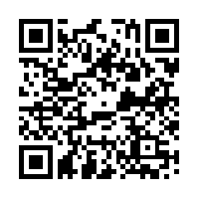
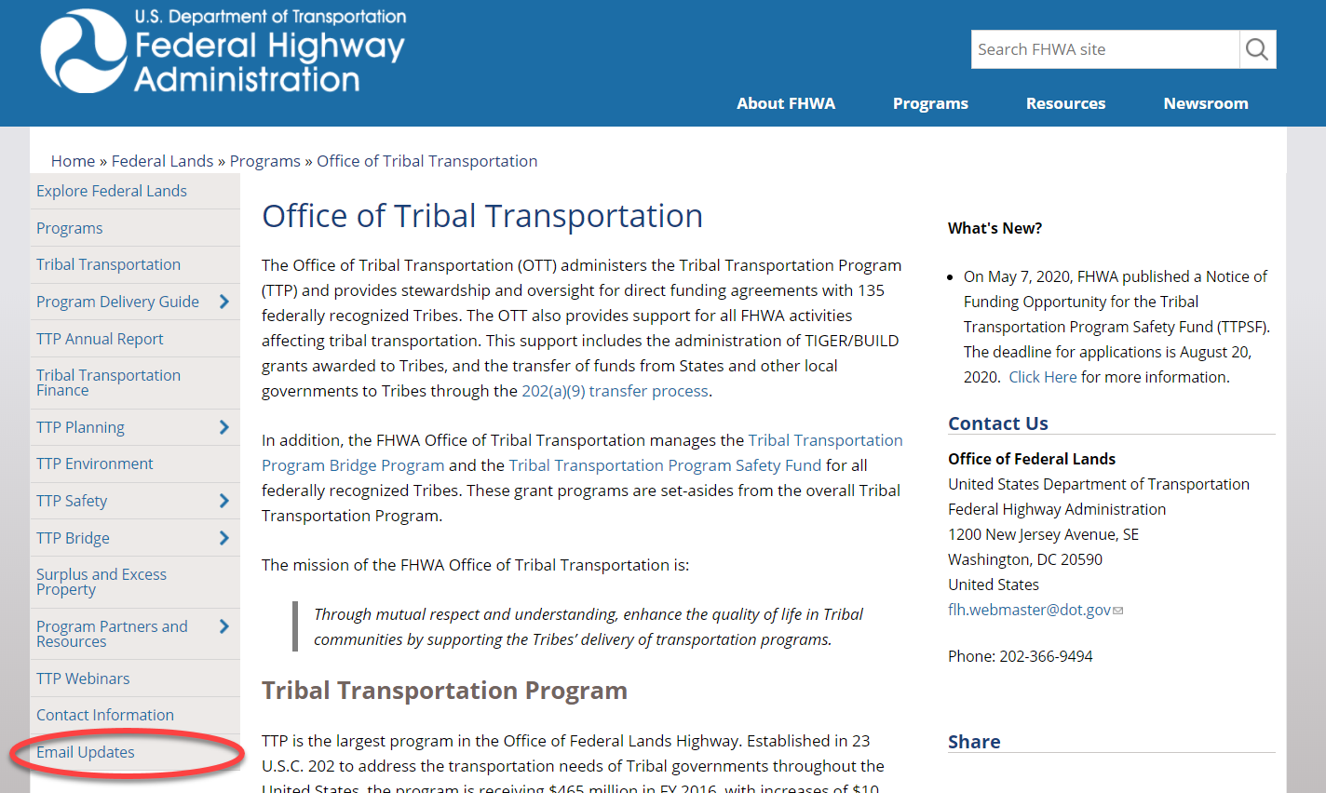
EMAIL LIST SERVE
https://highways.dot.gov/federal-lands/programs-tribal

Slide 15
THANK YOU!
Erin Kenley
Director, Office of Tribal Transportation, FHWA (202) 309-9908
Erin.kenley@dot.gov

