Slide 1
Tribal Transportation Program (TTP) and Bipartisan Infrastructure Law (BIL)* Overview
Brian Allen, Field Operations Manager
FHWA - Office of Tribal Transportation
December 7, 2022
*Also known as the “Infrastructure Investment and Jobs Act”

Slide 2
Today’s Topics
TTP BIL Funding
TTP Bridge Fund
TTP Safety Fund
TTP High Priority Projects
Nationally Significant Federal Lands and Tribal Projects Program (NSFLTP)
BIL Products

Slide 3
Tribal Transportation Program - BIL
Funding
FY22 - $578,460,000 (Contract Authority)
FY23 - $589,960,000 (Contract Authority)
FY24 - $602,460,000 (Contract Authority)
FY25 - $612,960,000 (Contract Authority)
FY26 - $627,960,000 (Contract Authority)
Total: $3,011,800,000

Slide 4
Tribal Transportation Program Bridge Fund
Tribal Transportation Facility Bridges
Eliminated 3% Set-aside from TTP
Bridge Formula Program – 3% Set-aside
$165 M/year (Advance Appropriations)
Bridge Investment Program Set-aside
$20 M/year (Advance Appropriations)
Bridge Investment Program Set-aside
FY22 $16 M (Contract Authority)
FY23 $18 M (Contract Authority)
FY24 $20 M (Contract Authority)
FY25 $22 M (Contract Authority)
FY26 $24 M (Contract Authority)
Please submit your applications!

Slide 5
Tribal Transportation Program Safety Fund
FY21
2% set-aside from TTP (Approximately $9 M available)
Awards announced in August
75 applications requesting $26 M
58 awards to 51 Tribes in 17 states
FY21 Tribal Transportation Program Safety Fund Awards.xlsx (dot.gov)
FY22
4% set-aside (Approximately $21 M available)
NOFO announced in June, Applications due September 12, 2022
152 applications requesting $95.8M
Recommending 93 projects to 70 Tribes in 22 states
FY23
Applications for the FY2023 funding cycle will be accepted now through January 15, 2023.
October 11, 2022 webinar available here
Grant Writing Workshop on December 1, will be recorded. Details.

Slide 6
BIA Indian Highway Safety Program
Three categories:
Highway Safety Specialist
Law Enforcement Grants
Child Safety Seat Grants
Highway Safety Specialists are a tribal staff position funded by BIA IHSP that can be tasked with developing and implementing your TTPSF funded safety plan.
Contact:
Kimberly Belone
BIA Office of Justice Services, Indian Highway Safety Program
(505)563-3900
Kimberly.Belone@bia.gov

Slide 7
High Priority Projects (HPP)
Nationwide priority program for:
An Indian Tribe or governmental subdivision of an Indian Tribe whose annual allocation of funding under the Tribal Transportation Program is insufficient to complete the highest priority project of the Indian Tribe or governmental subdivision of an Indian Tribe; or
Any Indian Tribe that has an emergency or disaster with respect to a transportation facility included on the national inventory of Tribal transportation facilities under section 202(b)(1) of Title 23, United States Code.

Slide 8
High Priority Projects (HPP)
$9 M/year set-aside from TTP (New)
$30 M/year subject to appropriations from the General Fund (Not included in the FY22 Consolidated Appropriations Act)
To be administered as described in MAP-21 (2012)
Will use the project scoring matrix from original 25 CFR 170
Still a lot of details to be worked out!

Slide 9
Nationally Significant Federal Lands and Tribal Projects Program (NSFLTP)
Funding - $275 M (FY 22-26) in contract authority from the HTF
Reduces (from $25 M to $12.5 M) minimum eligible project cost
Modifies the Federal share requirements:
Federal share for tribal projects is 100%;
For other projects, it allows Title 23 and Title 49 funds to be used for the “non‐Federal” share
Requires an even split between tribal and Federal lands projects
Of the funds for Federal lands projects, requires that at least 1 eligible project be carried out in a unit of the National Park System with ≥3 M annual visitors

Slide 10
National Significant Federal Lands and Tribal Project Program
FY21 - $100 M available
12 applications requesting $932 million
The Native Village of Eyak received $45,722,000
FY22 – $125 M available
Includes $75 M from the GF (FY22 Appropriations Act)
NOFO available on grants.gov
Funding Opportunity Number 693JJ3-NSFLTP-FY22
Title - 2022 Nationally Significant Federal Lands and Tribal Projects Program
Application window closed October 24, 2022

Slide 11
FHWA Awards Nearly $9 Million for Tribal Transportation Safety Improvements and Announces Additional $120 Million Available Thanks to President’s Bipartisan Infrastructure Law | FHWA (dot.gov)
Issued June 7th
References FY21 TTPSF Awards
Announces the FY22 TTPSF NOFO
Rolls out the TTPBF Guidance (Q&A’s)
Rolls out the “Transportation Funding Opportunities for Tribal Nations” Brochure

Slide 12
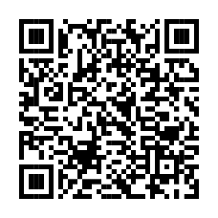
Transportation Funding Opportunities for Tribal Nations (dot.gov)
Federal Role
How to Access Fundings
Dedicated Tribal Programs and Other Programs
Outlines:
Purpose
Funding
Program Type
Federal Share
Eligible activities
BIL Changes to TTP
Additional Information and Assistance

Slide 13
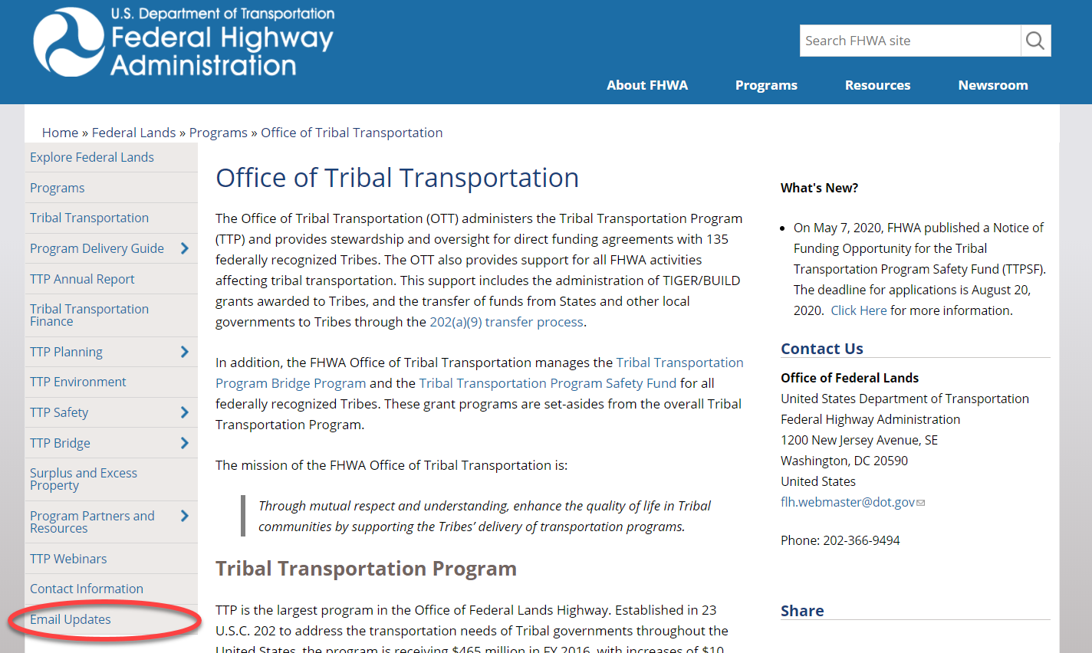
EMAIL LIST SERVE
https://highways.dot.gov/federal-lands/programs-tribal

Slide 14
Questions
Brian Allen, P.E. brian.allen@dot.gov
(360) 314-8051

